Slide 1
Estimation of Distribution Algorithms (EDAs)
Jamie Caldwell
PHD Student – Supervised by Dr Watson

Slide 2
Motivation
Inspired by Biological Evolutionary Process
Evolution can be observed as an optimisation process
Can not predict the future or observe problem structure
Black-Box Optimisation
Genetic Algorithms believed to work because of Building Block Hypothesis
Intuitive idea of having sub-problems, solving these sub-problems and combining to find the global solution
But mutation and crossover would not conserve building blocks
Difficult to apply to engineering constraint optimisation problems in the real world
How can a GA be improved such that optimisation problems can be solved with problem structure present in the ’real world’

Slide 3
Black-Box Optimisation
No knowledge of how the fitness of a solution is calculated
Can’t see the structure and contributions from individual components of a solution
Only know the total fitness to a complete solution
Fitness Function
FITNESS FUNCTION
SOLUTION
FITNESS

Slide 4
Encoding of a Problem
 | X₁ | X₂ | X₃ | X₄ | X₅ | X₆
Variable State | 1 | 1 | 1 | 0 | 0 | 1
Candidate Solution =
Discrete binary representation
Benchmark Problems
Simplistic representations that resemble the difficulties present in real world optimisation problems
Candidate Solution =
1 1 1 0 0 1
1 1 1 0 0 1
1 0 1 0 0 1
Population of Candidate Solutions =
1 1 1 1 0 1
0 0 0 0 1 0
These toy problems represent simplistic representatins of the contraints realised in real work problems

Slide 5
Genetic Algorithms (GAs)
Selection, Crossover and Mutation as search operator
1 1 1 0 0 1
1 1 1 0 0 1
1 1 1 0 0 1
Crossover
and
Mutation
1 0 1 0 0 1
0 1 1 1 0 1
0 1 1 1 0 1
1 1 1 1 0 1
1 0 1 0 0 1
1 1 1 1 0 1
0 0 0 0 1 0
0 0 0 0 1 0
0 1 1 0 1 1
Generate new Solutions and replaced removed.
Generation: G+1
Population at Generation G
Calculate each solutions fitness and SELECT fittest
Uniform/two-point crossover
With mutation

Slide 6
Genetic Algorithms
Global Optimum

Slide 7
Genetic Algorithms

Slide 8
Genetic Algorithms

Slide 9
Genetic Algorithms

Slide 10
Genetic Algorithms

Slide 11
Genetic Algorithms

Slide 12
Genetic Algorithms
Global Optimum Found 👍

Slide 13
Probabilistic Model Building GA’s (EDA’s)
Combination of Genetic Algorithms and Machine Learning Methods
1 1 1 0 0 1
1 1 1 0 0 1
1 1 1 0 0 1
1 0 1 0 0 1
0 1 1 1 0 1
PROBABILISTIC MODEL
1 0 1 0 0 1
1 1 1 1 0 1
1 0 1 0 0 1
1 1 1 0 0 1
0 0 0 0 1 0
0 0 0 0 1 0
0 1 1 1 0 1
Sample Model to Generate New Solutions and replaced removed
Generation: G+1
Population at Generation G
Selection
Build Probabilistic Model
Building and Sampling from a Probabilistic Model replaces the Mutation and Crossover Operator

Slide 14
Probabilistic Model
Data to be Modelled
Candidate Solution | X₁ | X₂ | X₃ | X₄ | X₅ | X₆
Solution 1 | 1 | 1 | 1 | 0 | 0 | 1
Solution 2 | 1 | 0 | 1 | 0 | 0 | 1
Solution 3 | 1 | 1 | 1 | 1 | 0 | 1
Solution 4 | 0 | 0 | 0 | 0 | 1 | 0
Construct a probabilistic model each generation that represents the selected population
Sample the probabilistic model to generate new candidate solutions
Simplest is a Univariate Model – Probability Vector
Construct the Model
 | x₁ | x₂ | x₃ | x₄ | x₅ | x₆
Frequency of ones | 3 | 2 | 3 | 1 | 1 | 3
The Model
 | x₁ | x₂ | x₃ | x₄ | x₅ | x₆
P(x_{i}=1) | 0.75 | 0.5 | 0.75 | 0.25 | 0.25 | 0.75
Notes:
Just building a model a generating is going to produce the same distribution of solutions. This is why I need a selection pressure to move the search space into region of fitter solution space

Slide 15
Univariate Marginal Distribution Algorithm
Model: Simple Probability Vector (univariate model)
Example: OneMax
1 1 1 0 0 1
1 0 1 0 0 1
1 1 1 1 0 1
0 0 0 0 1 0
Population at Generation G

Slide 16
Univariate Marginal Distribution Algorithm
Model: Simple Probability Vector (univariate model)
Example: OneMax
1 1 1 0 0 1
1 1 1 0 0 1
1 0 1 0 0 1
0 1 1 1 0 1
1 1 1 1 0 1
1 0 1 0 0 1
0 0 0 0 1 0
0 0 0 0 1 0
Population at Generation G
Selection

Slide 17
Univariate Marginal Distribution Algorithm
Model: Simple Probability Vector (univariate model)
Example: OneMax
1 1 1 0 0 1
1 1 1 0 0 1
1 0 1 0 0 1
0 1 1 1 0 1
 | x₁ | x₂ | x₃ | x₄ | x₅ | x₆
P(x_{i}=1) | 0.5 | 1 | 1 | 0.5 | 0 | 1
1 1 1 1 0 1
1 0 1 0 0 1
0 0 0 0 1 0
0 0 0 0 1 0
Population at Generation G
Selection
Build Probabilistic Model

Slide 18
Univariate Marginal Distribution Algorithm
Model: Simple Probability Vector (univariate model)
Example: OneMax
1 1 1 0 0 1
1 1 1 0 0 1
1 1 1 0 0 1
1 0 1 0 0 1
0 1 1 1 0 1
1 0 1 0 0 1
 | x₁ | x₂ | x₃ | x₄ | x₅ | x₆
P(x_{i}=1) | 0.5 | 1 | 1 | 0.5 | 0 | 1
1 1 1 1 0 1
1 0 1 0 0 1
1
1
1
0
0
1
0 0 0 0 1 0
0 0 0 0 1 0
0
1
1
1
0
1
Sample Model to Generate New Solutions and replaced removed
Generation: G+1
Population at Generation G
Selection
Build Probabilistic Model

Slide 19
Univariate Marginal Distribution Algorithm
Replace Population with Generation G+1
1 1 1 0 0 1
1 1 1 0 0 1
1 1 1 0 0 1
1 0 1 0 0 1
0 1 1 1 0 1
1 0 1 0 0 1
 | x₁ | x₂ | x₃ | x₄ | x₅ | x₆
P(x_{i}=1) | 0.5 | 1 | 1 | 0.5 | 0 | 1
1 1 1 1 0 1
1 0 1 0 0 1
1 1 1 0 0 1
0 0 0 0 1 0
0 0 0 0 1 0
0 1 1 1 0 1
Sample Model to Generate New Solutions and replaced removed
Generation: G+1
Population at Generation G
Selection
Build Probabilistic Model

Slide 20
OneMax Benchmark Problem
Maximise the number of ones of a bitstring
Easy Benchmark test for GA
Global Optimum is all ones
UMDA works well
So does a GA with crossover and mutation
So does a hill-climber
Why use a GA or EDA instead of a Hill Climber?
Problems with modularity
Fitness Cross - Section
000000
111111

Slide 21
Problems with Modularity
Deceptive Trap Problem
Sub-sets (modules) of variables are strongly correlated
Epistasis
The fitness contribution of a single bit is no longer independent
Rather, a single-bits fitness is only realised in the context of the module (combination of bits)
Eg. Nut and Bolt
Global Optimum
11111
Fitness of a single bit is deceptive

Slide 22
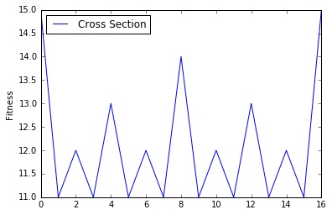
Problems with Modularity
Module Constraint
Creating problems with many modules
Requires learning which variables are correlated
Searching the dimension of modules rather than single-bits
Benchmark Problems
Deceptive Trap – k-trap
Hierarchical If and Only If (HIFF)
Modular Constraint
Ising Spin Glass
Causes a rugged landscape
HIFF

Slide 23
UMDA on Deceptive Trap
Univariate Statistics are not helpful.
0 provides a better fitness improvement than a 1 on average
Fitness
Selection
1 1 1 0 0
1
1 1 1 0 0
1 1 1 1 1
5
1 1 1 1 1
 | x₁ | x₂ | x₃ | x₄ | x₅
P(x_{i}=1) | 0.5 | 0.5 | 0.5 | 0.5 | 0.5
1 0 1 1 1
0
1 0 1 1 1
Probability Vector
0 0 0 0 0
4
0 0 0 0 0
A model that captures multivariate dependencies
11111 would provide a better fitness improvement than 00000, 00001, 00011 etc

Slide 24
Multivariate Model
Selected Examples
1 1 1 0 0
Tree model - (Baluja, Davies, 1997)
Conditional Probabilites
What does X₄ depend on?
Limitation on the conditional probabilities that can be represented
Want to be able to generalise problem structure
Therefore need a model that can learn the conditional dependencies independent of there location on a bit string
Linkage learning
0 0 0 0 1
P(X₁=1)
0.33
X₁
0 0 1 1 1
X₁ | P(X₂=1|X₁)
0 | 0
1
X₃
X₂
1.0
X₁ | P(X₃=1|X₁)
0 | 0.5
1 | 1.0

Slide 25
Bayesian Optimisation Algorithm
Bayesian Optimisation Algorithm, Martin Pelikan (2000)
Uses a Bayesian Network as the model
Bayesian Model is constructed for each generation
It’s constructed to best represent the selected solutions
The model is sampled from to generate new solutions
One of the most sophisticated Machine Learning models available at the time
Ability to represent complex conditional probabilities
A model that generalises well for many problems
X₁
X₃
X₂
X₇
X₈
X₅
X₆
X₄

Slide 26
Bayesian Network (BN)
Encodes a joint probability distribution between variables
Acyclic directed Graph
Nodes represent variables (X_{1,} X₂ … X_{n})
Conditional Dependencies represented by edges in a graph
Conditional Independencies
X₁
Tree Structure = Limited
X₁
X₅
X₂
X₉
X₈
X₃
X₂
X₃
X₆
X₄
X₇
X₅
X₆
X₄

Slide 27
Building a Bayesian Network
Task: Construct a Bayesian Network that represents the selected population
Complexity of doing this exactly is exponential – not good
Restrict the expressive power of the network such that a model can be built in polynomial time
Potentially not the best possible BN to represent the data
But that’s OK. It never-the-less provides a good estimation of the variable state distribution in the population.
We don’t need it to be exact
As long as it provides a better than average network
And will outperform the expressive power of a univariate model as although exact, cant encode conditional probabilities

Slide 28
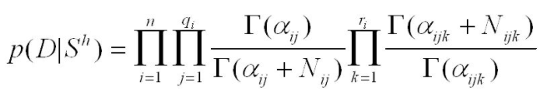
Building a Bayesian Network
X₉
Start with an empty network (no edge connections)
Restrictions
Number of incoming edges (k) to a node is constant
Reduces the order of interactions possible
Only Edge additions are allowed
No edge reversal
No edge removal
Determining which edge to add
Scoring metric: Bayesian Dirichlet Metric
Informs how good the network represents the data
Greedy Algorithm to add edge
Add the edge that increases the BDM the most
Then recalculate DBM for all possible edge additions and repeat
When no more edge additions would improve the BDM stop
Sounds computationally expensive but is Polynomial with respect to number of variables and population size
X₈
X₇
K=2

Slide 29
Generating a new Solution from BN
All conditional probabilities (defined by the edge connections in the BN) are calculated using the selected population
Forward sampling is used to generate a solution from the BN
Calculate variable states of all parent nodes
Calculate variable states of all nodes whose parents states are known
Probabilities of variables values is conditional on what the parents values are
X₁
X₅
Example: Nodes = 6
K = 2
X₆
X₂
X₄
X₃

Slide 30
Generating a new solution from the BN
X₁ | P(X₁=1)
 | 0.5
X₅ | P(X₅=1)
 | 0.5
X₁ | X₂ | X₃ | X₄ | X₅ | X₆
0
1
0
1
1
0
X₆ | X₁ | P(X₆=1|X₁)
 | 0 | 0.0
 | 1 | 1.0
X₄ | X₅ | P(X₄=1|X₅)
 | 0 | 0.5
 | 1 | 1.0
0
0
1
0
0
0
1 1 1 1 1 1
X₂ | X₅ | X₆ | P(X₂=1|X₅,X₆)
 | 0 | 0 | 0.0
 | 0 | 1 | 0.5
 | 1 | 0 | 1.0
 | 1 | 1 | 0.5
1 0 1 1 0 1
X₃ | X₆ | P(X₃=1|X₆)
 | 0 | 0.5
 | 1 | 1.0

Slide 31
BOA – Pseudo Code
Initialise a population of N random bit-string solutions
Calculate the fitness of each solution
Select the top fittest 50%
Construct a Bayesian Network that represents the selected population
Generate N/2 solutions from the Bayesian Network using forward sampling
Combine the generated solutions with the ‘selected for’ population
Repeat steps 2 – 6 until population has converged to a solution
BOA will converge when the BN constructed has probabilities of 1.0 or 0

Slide 32
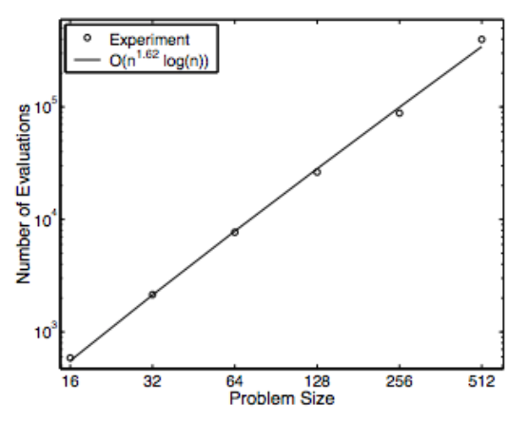
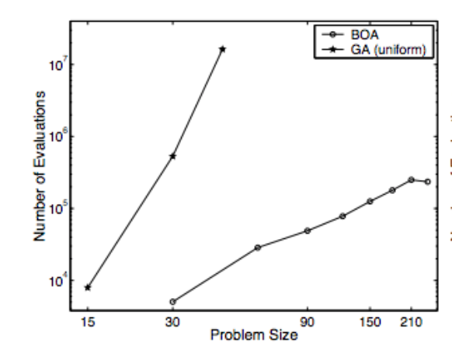
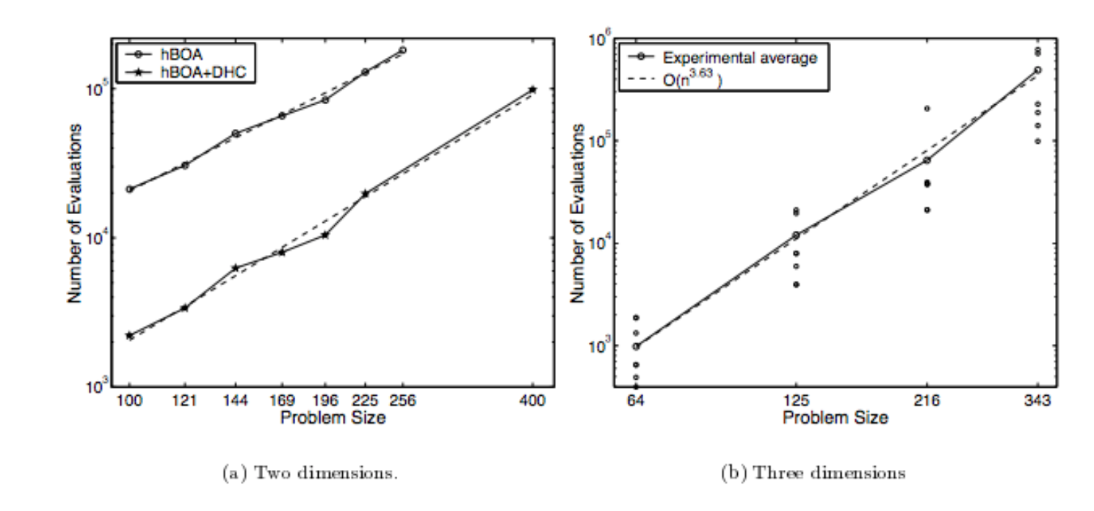
BOA’s Results – Pelikan(2002)
HIFF: Polynomial
Deceptive Trap (modules of size 3)
GA using Uniform Crossover = Exponential
BOA = Polynomial
Ising Spin Glasses: Polynomial

Slide 33
EDA - Summary
Crossover and mutation operator in a GA is replaced by a Probabilistic Model
A Bayesian Network in the case of BOA
The model is built (or updated) every generation using the selected proportion of the population
The model is sampled from to generate new solutions
These solutions replace the unfit solutions in the previous generation to create a new generation
Capable of modelling conditional probabilities
Capable of linkage learning
Allows for applicability to a wider range of problems (generalises) than GAs
Complex and random problem structures
Domain specific algorithms will also be that bit faster, but then they cant generalise

Slide 34
More Advance Model
Leading Model Building Optimisation Algorithms in Literature:
Hierarchical BOA
DSMGA – Dependency Structure Matrix
MOA – Markov Chain Model
LTGA – Linkage Tree Model
P3 – Essentially a Parameter less version of LTGA
All EDA’s follow the same algorithm:
Only the model is has changed
And how the model is sampled to generate new solutions

Slide 35
Current Research
Change the selection pressure:
EDA’s use ’filter selection’: filter fit solutions before building a probabilistic model
’Constructive Selection’: Apply selection after the model has generated a solution
Can solve problems that were previously impossible
Inspired by Extended Evolutionary Synthesis
Change the model used:
Why a Bayesian Model? Advanced for its time (2000)
Todays powerful learning model: Deep Learning

